Slide 1

Introduction to our Restaurant Management
Unlock the full potential of restaurant with our comprehensive management system. Streamline operations, enhance customer experience, and drive business growth through data-driven insights.

Slide 2
Table of Contents
Key Features and functionalities
Abstract
Class Diagram
Code
Execution

Slide 3
Team Members
2320030093 – M. Srija
2320030097 – S. Karthikeya
2320030100 – S. Harshavardhan
2320030103 – N. Narayanam
2320030109 – M.V.S Bharat
2320030106 – J. Sri Harshitha

Slide 4
Key Features and Functionalities
Order Management
Inventory Tracking
Streamline order processing, track order status, and manage customer requests efficiently.
Real-time monitoring of ingredient levels, automated reordering, and waste reduction.
Analytics and Reporting
Gain insights into sales trends, customer preferences, and operational efficiency to drive business decisions.

Slide 5
ABSTRACT
1
Actionable Analytics
2
Predictive Modeling
Our restaurant management system provides real-time data and insights to help you make informed decisions. Track sales, inventory, and customer trends to optimize operations.
Leverage machine learning algorithms to forecast demand, staffing needs, and purchasing requirements. Stay ahead of the curve and make proactive adjustments.
3
Customizable Dashboards
4
Data-Driven Reporting
Visualize key performance indicators through a user-friendly dashboard. Quickly identify areas for improvement and monitor progress towards your goals.
Generate comprehensive reports on sales, inventory, labor, and customer data. Uncover valuable insights to drive strategic decision-making.

Slide 6

Modern vs Traditional Restaurant Management Systems
Discover how our innovative solutions, such as personalized menus and seamless online ordering, can elevate your customer experience and help you stay ahead of the competition. Upgrade to modern restaurant management software to streamline operations, improve inventory management, enhance customer relationship management, gain data-driven insights, and achieve scalability and flexibility

Slide 7
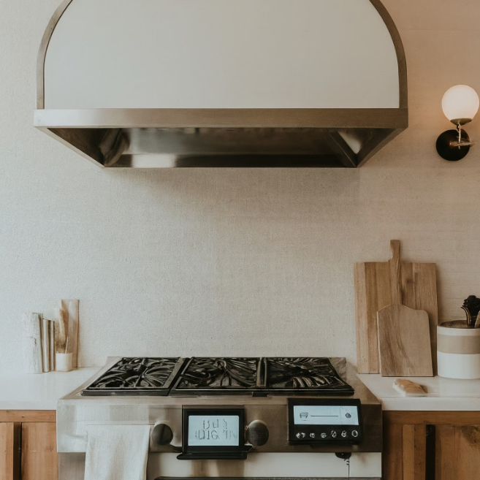
Inventory management
Effectively managing your restaurant's inventory is crucial for cost control and operational efficiency. Our system provides real-time visibility into stock levels, enabling you to optimize purchasing, minimize waste, and ensure you always have the right ingredients on hand.
Track ingredients, supplies, and equipment with ease. Set low stock alerts, generate detailed reports, and automate ordering to streamline your inventory processes.

Slide 8
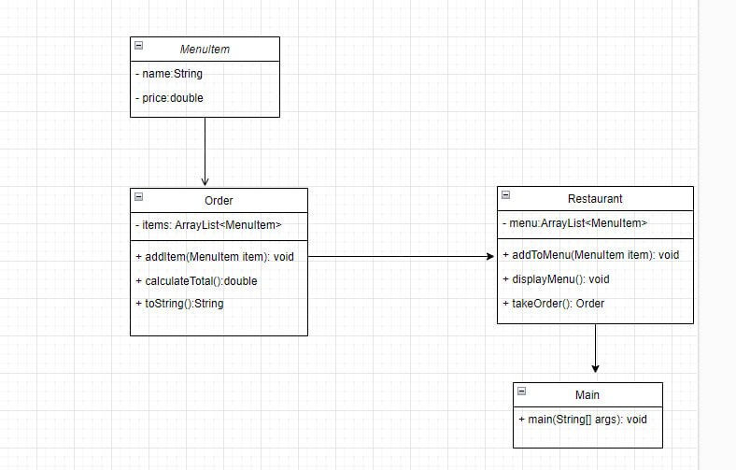
Class Diagram

Slide 9
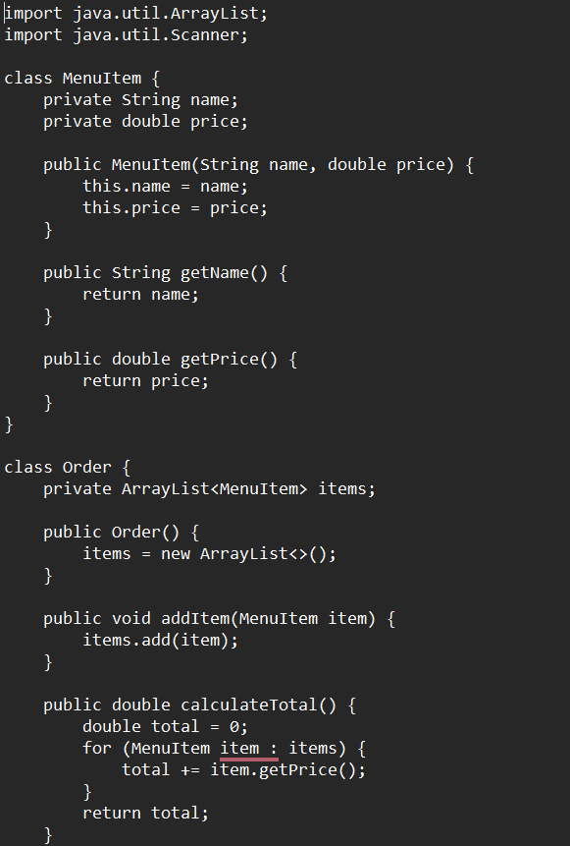
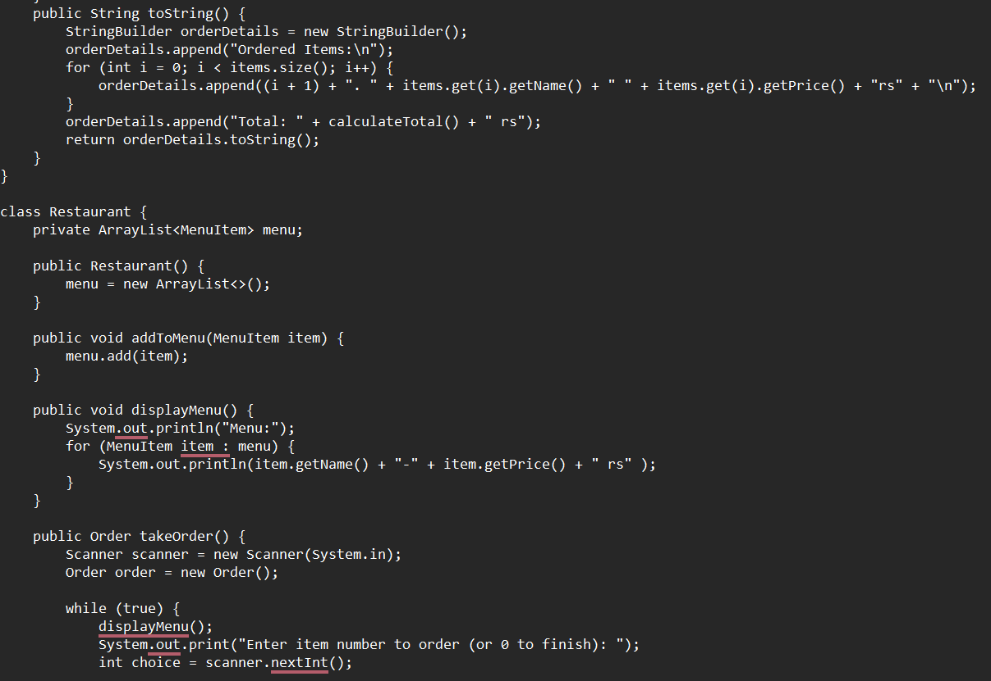
CODE

Slide 10
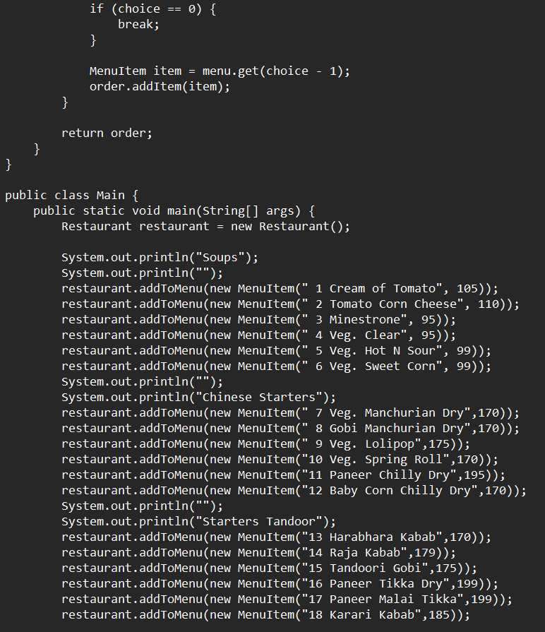
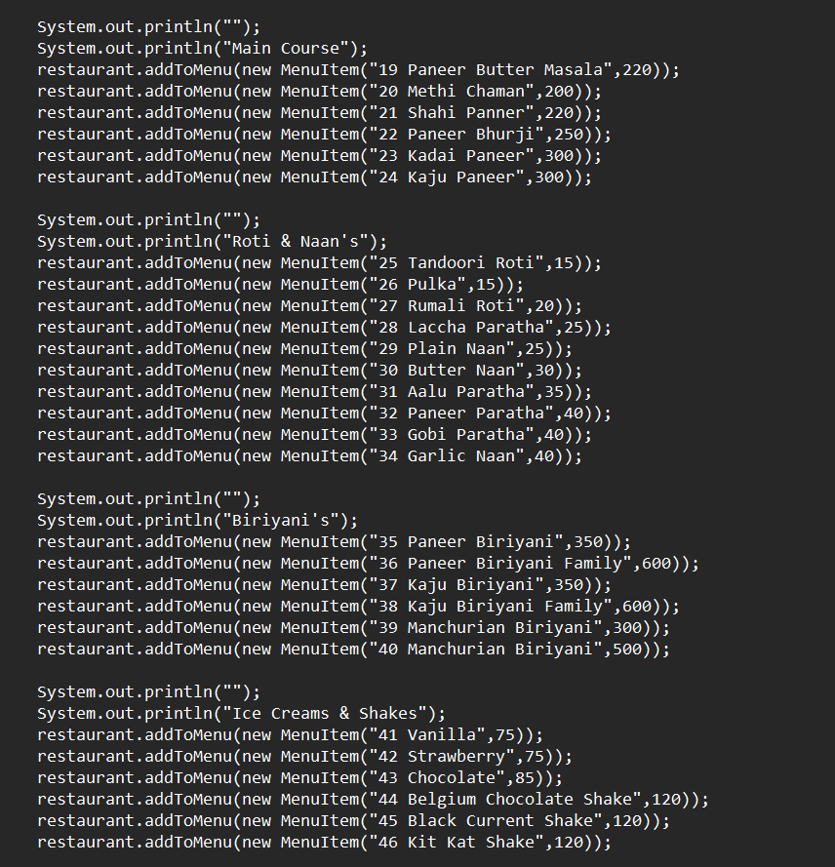

Slide 11
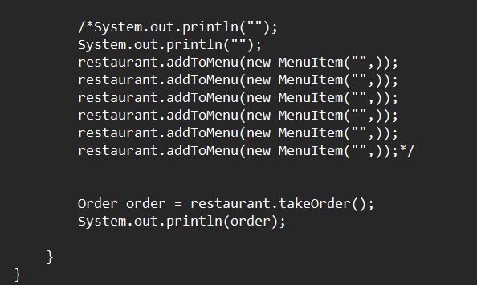
CODE

Slide 12



Scalability and flexibility
Scalable infrastructure
1
Accommodate growing business needs
Flexible deployment
2
On-premises or cloud-based options
Customizable workflows
3
Tailor to your unique operations

Slide 13

Conclusion and next steps
In conclusion, our cloud-based restaurant management system offers a comprehensive solution to streamline your operations, enhance customer experiences, and drive data-driven insights. By leveraging the power of modern software, you can elevate your business to new heights.
As we move forward, we are committed to continuously enhancing our platform to meet your evolving needs. Our team of experts is ready to guide you through the next steps, ensuring a seamless implementation and ongoing support.

